Slide 1
Lecture 13 Heaps and priority queues
EECS-214

Slide 2

Queues
Simplified sequence data structure
Insertions only at the end (“tail”)
Deletions only from the beginning (“head”)
First-in, first out
Objects are dequeued in the order they were enqueued
Simple API
Enqueue: add item to the end of the queue
Dequeue: remove item from the front

Slide 3

Priority queues
Like normal queues
Objects wait in line to be processed
However, items have an associated numeric priority
Priority specified when added to queue
Objects removed from queue in order of priority
Slightly different API
Insert(object, priority)
Adds object with specified priority
ExtractMax()
Returns highest priority object

Slide 4
Priority queues
Like normal queues
Objects wait in line to be processed
However, items have an associated numeric priority
Priority specified when added to queue
Objects removed from queue in order of priority
Slightly different API
Insert(object, priority)
Adds object with specified priority
ExtractMin()
Returns lowest priority object

Slide 5
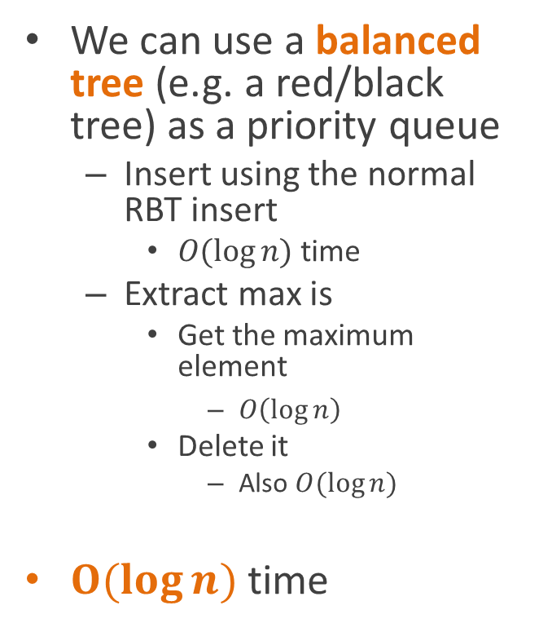
Implementing priority queues
We can use a balanced tree (e.g. a red/black tree) as a priority queue
Insert using the normal RBT insert
$O(\log{n)}$ time
Extract max is
Get the maximum element
$O\left(\log{n}\right)$
Delete it
Also $O(\log{n})$
$O(log{n)}$ time
7
2
9
1
5
8
4

Slide 6
Implementing priority queues
Unfortunately, red/black trees are pretty complicated
They go to a lot of work to keep all the items perfectly sorted
Is there something simpler we could do?
7
2
9
1
5
8
4

Slide 7
Heaps
9
Heaps are a simple tree structure for implementing priority queues
Rather than requiring their in-order traversal to be sorted
We just require that parent nodes be larger than their child nodes
Or smaller, if it’s a min heap
There are lots of exotic types of heaps
We’ll focus on binary heaps
Which are complete binary trees with the heap property
We’ll get to the completeness thing in a minute…
7
8
1
6
4
5
3
2

Slide 8
Heaps
9
Proposition: the largest element of a heap is always its root
Proof:
Suppose some other element is the largest element
Since it isn’t the root, it must have a parent
Since it’s the largest element, it must be larger than its parent
But that contradicts the definition of a heap
So the largest element must be the root
7
8
1
6
4
5
3
2

Slide 9
Sketch of heap algorithms
ExtractMax (version 1)
We know the root is the maximal element
So we want to delete it and return it
But we need to replace it with its largest child
So we find the largest child
And recursively delete it from its subtree
9
7
8
1
6
4
5
3
2

Slide 10
Sketch of heap algorithms
ExtractMax (version 1)
We know the root is the maximal element
So we want to delete it and return it
But we need to replace it with its largest child
So we find the largest child
And recursively delete it from its subtree
9
7
8
1
6
4
5
3
2
However, this is going to turn out to not to be the most convenient algorithm

Slide 11
Sketch of heap algorithms
ExtractMax (verison 2)
Replace the root with a leaf node
Getting to a leaf will turn out to be easy
The leaf node is probably too small
So move it downward in the tree to make it be a proper heap again
9
7
8
1
6
4
5
3
2

Slide 12
Sketch of heap algorithms
ExtractMax(heap) result = root of heap
replace root with leaf
Heapify(heap)
return result
9
7
8
1
6
4
5
3
2

Slide 13
Sketch of heap algorithms
Heapify(root)
if root > children
done
else if left child > root and
left child > right child
swap root and left child
Heapify(left child)
else
swap root and right child
Heapify(right child)
9
7
8
1
6
4
5
3
2

Slide 14
Example
Starting configuration
9
8
7
1
6
4
5
3
2

Slide 15
Example
Replace root with leaf
Violates heap property
2
8
7
1
6
4
5
3

Slide 16
Example
Replace root with leaf
Swap with largest child
Still violates heap property
8
2
7
1
6
4
5
3

Slide 17
Example
Replace root with leaf
Swap with largest child
Swap with largest child again
Still violates heap property
8
6
7
1
2
4
5
3

Slide 18
Example
Replace root with leaf
Swap with largest child
Swap with largest child again
Swap with largest child again
Now a proper heap
8
6
7
1
5
4
2
3

Slide 19
Sketch of heap algorithms
Insert(item)
Add item as a leaf
Again, trust us, this will turn out to be easy
While item > its parent
Swap with parent
Compare it to the next level up
9
7
8
1
6
4
5
3
2

Slide 20
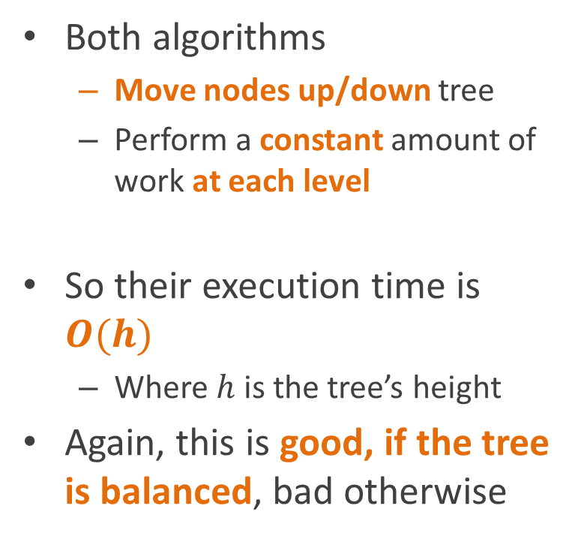
Analysis
Both algorithms
Move nodes up/down tree
Perform a constant amount of work at each level
So their execution time is $O(h)$
Where $h$ is the tree’s height
Again, this is good, if the tree is balanced, bad otherwise
9
7
8
1
6
4
5
3
2

Slide 21
Complete binary trees
A complete binary tree is a binary tree in which
Every level of the tree is full, except possibly the last
Can’t add anymore nodes
Every node is shifted as far to the left as possible
Complete trees are optimally balanced
9
7
8
1
6

Slide 22
Binary heaps
A binary heap is a
Complete binary tree
That satisfies the heap property
Great!
How do we ensure that the heap is a complete binary tree?
9
7
8
1
6

Slide 23
Embedding in an array
It turns out that any complete binary tree can be embedded an array in a particularly cleaver way
We can compute
The position of its parent in the array,
and the positions of its children,
directly from its own position
9
7
8
1
6

Slide 24
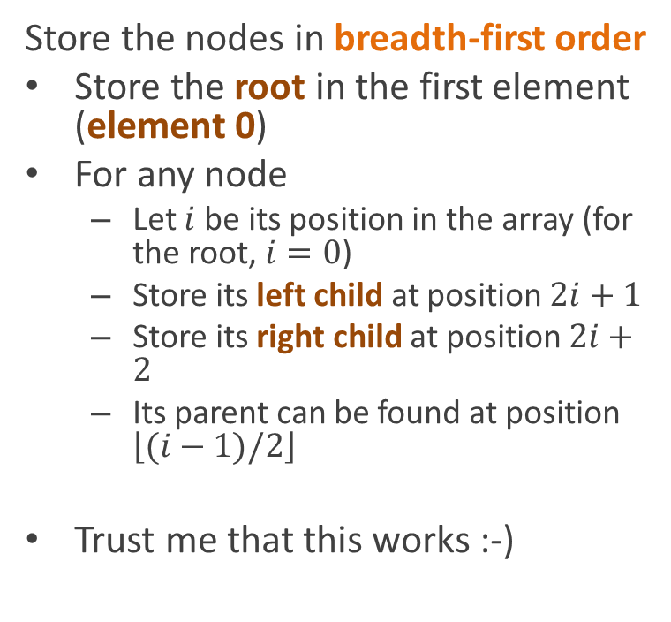
Embedding in an array
Store the nodes in breadth-first order
Store the root in the first element (element 0)
For any node
Let $i$ be its position in the array (for the root, $i=0$)
Store its left child at position $2i+1$
Store its right child at position $2i+2$
Its parent can be found at position $\left\lfloor (i−1)/2\right\rfloor$
Trust me that this works :-)
9
7
8
1
6
9
7
8
1
6

Slide 25
Why is this a good representation?
Very fast
Can just allocate a big array and then never have to call new again
Last element is always a leaf
Remember our algorithms needed to add/remove leaves?
9
7
8
1
6
9
7
8
1
6

Slide 26
Representing a heap using an array
Assume we have an extra field for the array to keep track of the size of the heap
Define the following utility procedures:
Parent(int i)
return (i-1)/2
Left(int i)
return 2*i+1
Right(int i)
return 2*i+2
9
7
8
1
6
9
7
8
1
6

Slide 27
Heap insertion using the array representation
HeapInsert(A, key)
A.size = A.size + 1
i = A.size-1
while i>0 and A[Parent(i)] < key
A[i] = A[Parent(i)]
i = Parent(i)
A[i] = key
9
7
8
1
6
9
7
8
1
6

Slide 28
Inserting 10
HeapInsert(A, key)
A.size = A.size + 1
i = A.size-1
while i>0 and A[Parent(i)] < key
A[i] = A[Parent(i)]
i = Parent(i)
A[i] = key
9
7
8
1
6
9
7
8
1
6

Slide 29
Check parent
HeapInsert(A, key)
A.size = A.size + 1
i = A.size-1
while i>0 and A[Parent(i)] < key
A[i] = A[Parent(i)]
i = Parent(i)
A[i] = key
9
7
8
1
6
?
9
7
8
1
6
?
i=5
Parent(i) = (5-1)/2 = 2

Slide 30
8 < 10, so A[Parent(i)] < key
HeapInsert(A, key)
A.size = A.size + 1
i = A.size-1
while i>0 and A[Parent(i)] < key
A[i] = A[Parent(i)]
i = Parent(i)
A[i] = key
9
7
8
1
6
?
9
7
8
1
6
?
i=5
Parent(i) = (5-1)/2 = 2

Slide 31
Copy parent down
HeapInsert(A, key)
A.size = A.size + 1
i = A.size-1
while i>0 and A[Parent(i)] < key
A[i] = A[Parent(i)]
i = Parent(i)
A[i] = key
9
7
8
1
6
8
9
7
8
1
6
8
i=5
Parent(i) = (5-1)/2 = 2

Slide 32
And move up tree
HeapInsert(A, key)
A.size = A.size + 1
i = A.size-1
while i>0 and A[Parent(i)] < key
A[i] = A[Parent(i)]
i = Parent(i)
A[i] = key
9
7
8
1
6
8
9
7
8
1
6
8
i=2

Slide 33
Check parent
HeapInsert(A, key)
A.size = A.size + 1
i = A.size-1
while i>0 and A[Parent(i)] < key
A[i] = A[Parent(i)]
i = Parent(i)
A[i] = key
9
7
8
1
6
8
9
7
8
1
6
8
i=2
Parent(i) = (2-1)/2 = 0 (remember int arithmetic rounds down)

Slide 34
9 < 10, so A[Parent(i)] < key
HeapInsert(A, key)
A.size = A.size + 1
i = A.size-1
while i>0 and A[Parent(i)] < key
A[i] = A[Parent(i)]
i = Parent(i)
A[i] = key
9
7
8
1
6
8
9
7
8
1
6
8
i=2
Parent(i) = (2-1)/2 = 0 (remember int arithmetic rounds down)

Slide 35
Copy parent down
HeapInsert(A, key)
A.size = A.size + 1
i = A.size-1
while i>0 and A[Parent(i)] < key
A[i] = A[Parent(i)]
i = Parent(i)
A[i] = key
9
7
9
1
6
8
9
7
9
1
6
8
i=2
Parent(i) = (2-1)/2 = 0 (remember int arithmetic rounds down)

Slide 36
Move up
HeapInsert(A, key)
A.size = A.size + 1
i = A.size-1
while i>0 and A[Parent(i)] < key
A[i] = A[Parent(i)]
i = Parent(i)
A[i] = key
9
7
9
1
6
8
9
7
9
1
6
8
i=0

Slide 37
Can’t move farther
HeapInsert(A, key)
A.size = A.size + 1
i = A.size-1
while i>0 and A[Parent(i)] < key
A[i] = A[Parent(i)]
i = Parent(i)
A[i] = key
9
7
9
1
6
8
9
7
9
1
6
8
i=0

Slide 38
Store the new key
HeapInsert(A, key)
A.size = A.size + 1
i = A.size-1
while i>0 and A[Parent(i)] < key
A[i] = A[Parent(i)]
i = Parent(i)
A[i] = key
10
7
9
1
6
8
10
7
9
1
6
8
i=0

Slide 39
Done!
HeapInsert(A, key)
A.size = A.size + 1
i = A.size-1
while i>0 and A[Parent(i)] < key
A[i] = A[Parent(i)]
i = Parent(i)
A[i] = key
10
7
9
1
6
8
10
7
9
1
6
8
Notice that this is once again a valid heap

Slide 40
Extracting an element
HeapExtractMax(A)
max = A[0]
A[0] = A[A.size-1]
A.size--
Heapify(A,0)
return max
10
7
9
1
6
8
10
7
9
1
6
8

Slide 41
Extracting an element
Heapify(A, i)
l = Left(i)
r = Right(i)
if l≤A.size and A[l]>A[i]
largest = l
else
largest = i
if r≤A.size and A[r]>A[largest]
largest = r
if largest≠i
swap A[i] and A[largest]
Heapify(A, largest)
10
7
9
1
6
8
10
7
9
1
6
8

Slide 42
Here we go!
HeapExtractMax(A) max = A[0]
A[0] = A[A.size-1]
A.size--
Heapify(A,0)
return max
10
7
9
1
6
8
10
7
9
1
6
8

Slide 43
Remember the max (the root)
HeapExtractMax(A)
max = A[0]
A[0] = A[A.size-1]
A.size--
Heapify(A,0)
return max
10
7
9
1
6
8
10
7
9
1
6
8

Slide 44
Move the last leaf to the root
HeapExtractMax(A)
max = A[0]
A[0] = A[A.size-1]
A.size--
Heapify(A,0)
return max
8
7
9
1
6
8
7
9
1
6

Slide 45
Re-heapify
HeapExtractMax(A)
max = A[0]
A[0] = A[A.size-1]
A.size--
Heapify(A,0)
return max
8
7
9
1
6
8
7
9
1
6

Slide 46
Re-heapify
Heapify(A, i)
l = Left(i)
r = Right(i)
if l≤A.size and A[l]>A[i]
largest = l
else
largest = i
if r≤A.size and A[r]>A[largest]
largest = r
if largest≠i
swap A[i] and A[largest]
Heapify(A, largest)
8
7
9
1
6
8
7
9
1
6
i=0

Slide 47
Find the left- and right-children
Heapify(A, i)
l = Left(i)
r = Right(i)
if l≤A.size and A[l]>A[i]
largest = l
else
largest = i
if r≤A.size and A[r]>A[largest]
largest = r
if largest≠i
swap A[i] and A[largest]
Heapify(A, largest)
8
7
9
1
6
8
7
9
1
6
i=0
l=1
r=2

Slide 48
A[l] not > A[i]
Heapify(A, i)
l = Left(i)
r = Right(i)
if l≤A.size and A[l]>A[i]
largest = l
else
largest = i
if r≤A.size and A[r]>A[largest]
largest = r
if largest≠i
swap A[i] and A[largest]
Heapify(A, largest)
8
7
9
1
6
8
7
9
1
6
i=0
l=1
r=2

Slide 49
So largest = i
Heapify(A, i)
l = Left(i)
r = Right(i)
if l≤A.size and A[l]>A[i]
largest = l
else
largest = i
if r≤A.size and A[r]>A[largest]
largest = r
if largest≠i
swap A[i] and A[largest]
Heapify(A, largest)
8
7
9
1
6
8
7
9
1
6
i=0
l=1
r=2
largest=0

Slide 50
A[r] > A[largest]
Heapify(A, i)
l = Left(i)
r = Right(i)
if l≤A.size and A[l]>A[i]
largest = l
else
largest = i
if r≤A.size and A[r]>A[largest]
largest = r
if largest≠i
swap A[i] and A[largest]
Heapify(A, largest)
8
7
9
1
6
8
7
9
1
6
i=0
l=1
r=2
largest=0

Slide 51
So update largest
Heapify(A, i)
l = Left(i)
r = Right(i)
if l≤A.size and A[l]>A[i]
largest = l
else
largest = i
if r≤A.size and A[r]>A[largest]
largest = r
if largest≠i
swap A[i] and A[largest]
Heapify(A, largest)
8
7
9
1
6
8
7
9
1
6
i=0
l=1
r=2
largest=2

Slide 52
largest isn’t i
Heapify(A, i)
l = Left(i)
r = Right(i)
if l≤A.size and A[l]>A[i]
largest = l
else
largest = i
if r≤A.size and A[r]>A[largest]
largest = r
if largest≠i
swap A[i] and A[largest]
Heapify(A, largest)
8
7
9
1
6
8
7
9
1
6
i=0
l=1
r=2
largest=2

Slide 53
So swap with i
Heapify(A, i)
l = Left(i)
r = Right(i)
if l≤A.size and A[l]>A[i]
largest = l
else
largest = i
if r≤A.size and A[r]>A[largest]
largest = r
if largest≠i
swap A[i] and A[largest]
Heapify(A, largest)
9
7
8
1
6
8
7
9
1
6
i=0
l=1
r=2
largest=2

Slide 54
And recurse
Heapify(A, i)
l = Left(i)
r = Right(i)
if l≤A.size and A[l]>A[i]
largest = l
else
largest = i
if r≤A.size and A[r]>A[largest]
largest = r
if largest≠i
swap A[i] and A[largest]
Heapify(A, largest)
9
7
8
1
6
9
7
8
1
6
i=2

Slide 55
Find children
Heapify(A, i)
l = Left(i)
r = Right(i)
if l≤A.size and A[l]>A[i]
largest = l
else
largest = i
if r≤A.size and A[r]>A[largest]
largest = r
if largest≠i
swap A[i] and A[largest]
Heapify(A, largest)
9
7
8
1
6
9
7
8
1
6
i=2
l=5
r=6

Slide 56
l is off the end of the heap
Heapify(A, i)
l = Left(i)
r = Right(i)
if l≤A.size and A[l]>A[i]
largest = l
else
largest = i
if r≤A.size and A[r]>A[largest]
largest = r
if largest≠i
swap A[i] and A[largest]
Heapify(A, largest)
9
7
8
1
6
9
7
8
1
6
i=2
l=5
r=6

Slide 57
So largest is i
Heapify(A, i)
l = Left(i)
r = Right(i)
if l≤A.size and A[l]>A[i]
largest = l
else
largest = i
if r≤A.size and A[r]>A[largest]
largest = r
if largest≠i
swap A[i] and A[largest]
Heapify(A, largest)
9
7
8
1
6
9
7
8
1
6
i=2
l=5
r=6
largest=2

Slide 58
r is also off the end of the heap
Heapify(A, i)
l = Left(i)
r = Right(i)
if l≤A.size and A[l]>A[i]
largest = l
else
largest = i
if r≤A.size and A[r]>A[largest]
largest = r
if largest≠i
swap A[i] and A[largest]
Heapify(A, largest)
9
7
8
1
6
9
7
8
1
6
i=2
l=5
r=6
largest=2

Slide 59
largest=i
Heapify(A, i)
l = Left(i)
r = Right(i)
if l≤A.size and A[l]>A[i]
largest = l
else
largest = i
if r≤A.size and A[r]>A[largest]
largest = r
if largest≠i
swap A[i] and A[largest]
Heapify(A, largest)
9
7
8
1
6
9
7
8
1
6
i=2
l=5
r=6
largest=2

Slide 60
So we’re done
Heapify(A, i)
l = Left(i)
r = Right(i)
if l≤A.size and A[l]>A[i]
largest = l
else
largest = i
if r≤A.size and A[r]>A[largest]
largest = r
if largest≠i
swap A[i] and A[largest]
Heapify(A, largest)
9
7
8
1
6
9
7
8
1
6
i=2
l=5
r=6
largest=2

Slide 61
next time: applications of binary heaps

